Slide 1
Week 9
Assignment：Linear Programming
Name：张颜兵
Id：12132428
Department：MAE
SuperVisor：Prof.吴雷
Research Topic：Engineering calculation

Slide 2
E1 LP software packages
linprog(), fmincon() in MATLAB；
scipy.optimize.linprog() in python；
Excel;

Slide 3
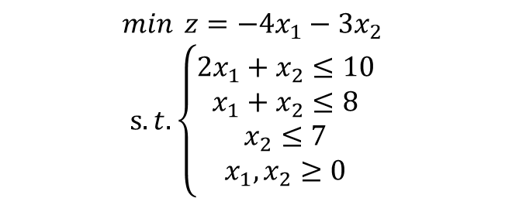

E2 simple examples
$$\min{ z=−4x_{1}−{3x}_{2}}$$
$$s.t.\left\{\begin{aligned}2x_{1}+x_{2}≤10 \\ x_{1}+x_{2}≤8 \\ x_{2}≤7 \\ x_{1},x_{2}≥0\end{aligned}\right.$$
$$\min{ z=x_{1}+2x_{2}}$$
$$s.t.\left\{\begin{aligned}x_{1}+x_{2}≥1 \\ {2x}_{1}+{5x}_{2}≥10\end{aligned}\right.$$
$$x_{1}=2，x_{2}=6，min=−26$$
$$x_{1}=−1.6667，x_{2}=2.6667，min=3.6667$$

Slide 4
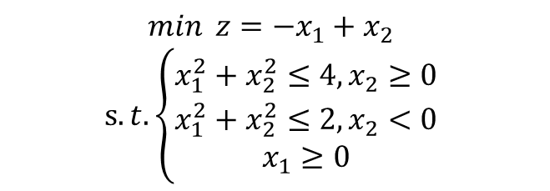

E3 multiple optimal solutions
$$\min{ z=−x_{1}+x_{2}}$$
$$s.t.\left\{\begin{aligned}x_{1}^{2}+x_{2}^{2}≤4,x_{2}≥0 \\ x_{1}^{2}+x_{2}^{2}≤2,x_{2}<0 \\ x_{1}≥0\end{aligned}\right.$$
$$\left\{\begin{aligned}x_{1}=1，x_{2}=−1 \\ x_{1}=2，x_{2}=0\end{aligned}\right.，min=−2$$

